Slide 1


Advanced Databases and Client-Server Applications
[12-6812-00L]
Lecture 15
Department of Computing
Sheffield Hallam University

Slide 2
Some questions...
What is a Procedure?
What is a Stored Procedure?
What is a Function?
Three similar but different things
• Subprograms are named PL/SQL blocks that
can take parameters and be invoked. PL/SQL has
two types of subprograms called procedures and
functions

Slide 3
Modularization
The process by which you break up large blocks of code into smaller pieces (modules) that can be called by other modules.
With modularization, your code becomes:
- More reusable
- More manageable
- More readable
- More reliable

Slide 4
Modularization
Procedure
A program that performs one or more actions and is called as an executable PL/SQL statement. You can pass information into and out of a procedure through its parameter list.
Function
A program that returns data through its RETURN clause, and is used just like a PL/SQL expression. You can pass information into a function through its parameter list. You can also pass information out via the parameter list, but this is generally considered a bad practice.
Database trigger
A set of commands that are triggered to execute (e.g., log in, modify a row in a table,
execute a DDL statement) when an event occurs in the database.
Package
A named collection of procedures, functions, types, and variables.
Object type or instance of an object type
Oracle’s version of (or attempt to emulate) an object-oriented class. Object types
encapsulate state and behaviour, combining data (like a relational table) with rules
(procedures and functions that operate on that data).

Slide 5
Procedures
A procedure is a sequence of program instructions that perform a specific task, packaged as a unit. This unit can then be used in programs wherever that particular task should be performed.
Procedures may be defined within programs, or separately in libraries that can be used by multiple programs.
In different programming languages, a procedure may be called a subroutine, a function, a routine, a method, or a callable unit.
A subroutine is often coded so that it can be called several times and from several places during one execution of the program, including from other procedures, and then return to the next instruction after the call once the subroutine's task is done.

Slide 6
Procedures
Decomposition of a complex task
Reusability of code across multiple programs
Traceability
Reduction of duplicated code
Example from PASCAL
procedure name(argument(s): type1, argument(s): type 2, ... );
< local declarations >
begin
< procedure body >
end;
A procedure definition in Pascal consists of a header, local declarations and a body of the procedure. A procedure will also have following three parts:
1. Declarative Part
2. Executable Part
3. Exception-handling

Slide 7
Stored Procedures
A stored procedure is a subroutine available to applications that access a relational database management system (RDBMS). Such procedures are stored in the database data dictionary.
A stored procedure is also termed proc, storp, sproc, StoPro, StoredProc, StoreProc, sp, or SP.
A stored procedure is a PL/SQL block that Oracle stores in the database and can be called by name from an application.
Used for data validation and access control.
In Oracle, procedures and stored procedures are the same thing.

Slide 8
Advantages of Stored Procedures
Performance
Productivity and Ease of Use
Scalability
Maintainability
Interoperability
Security
Replication

Slide 9
Stored Procedures Creation
A procedure can be created at:
Schema Level
Inside a package
Inside a PL/SQL block
A schema level procedure is a standalone procedure. It is created with the CREATE PROCEDURE statement. It is stored in the database and can be deleted with the DROP PROCEDURE statement.
A procedure created inside a package is a packaged procedure. It is stored in the database and can be deleted only when the package is deleted with the DROP PACKAGE statement.

Slide 10
Stored Procedure Creation at Schema Level
CREATE OR REPLACE procedure_name
[(parameter_name [IN | OUT | IN OUT] type [, ...])]
{ IS | AS }
BEGIN
procedure_body
[EXCEPTION
exception_section]
END procedure_name;
Example
CREATE OR REPLACE PROCEDURE greetings
AS
BEGIN
dbms_output.put_line('Hello World!');
END;

Slide 11
Stored Procedure Creation inside a Package
CREATE OR REPLACE PACKAGE BODY emp_mgmt AS
tot_emps NUMBER;
tot_depts NUMBER;
PROCEDURE hire
(last_name VARCHAR2, job_id VARCHAR2,
manager_id NUMBER, salary NUMBER,
commission_pct NUMBER, department_id NUMBER)
RETURN NUMBER IS new_empno NUMBER;
BEGIN
SELECT employees_seq.NEXTVAL
INTO new_empno
FROM DUAL;
INSERT INTO employees
VALUES (new_empno, 'First', 'Last','first.example@example.com',
'(415)555-0100','18-JUN-02','IT_PROG',90000000,00,
100,110);
tot_emps := tot_emps + 1;
RETURN(new_empno);
END;
END emp_mgmt;

Slide 12
Stored Procedure Creation
procedure-name specifies the name of the procedure.
[OR REPLACE] option allows modifying an existing procedure.
The optional parameter list contains name, mode and types of the parameters. IN represents that value will be passed from outside and OUT represents that this parameter will be used to return a value outside of the procedure.
procedure-body contains the executable part.

Slide 13
Stored Procedures Execution & Deletion
A standalone procedure can be called in two ways:
1. Using the EXECUTE keyword
2. Calling the name of the procedure from a PL/SQL block
The procedure 'greetings' can be called with the EXECUTE keyword:
EXECUTE greetings;
The procedure can also be called from another PL/SQL block:
BEGIN
greetings;
END;
A standalone procedure is deleted with the DROP PROCEDURE statement. Syntax for deleting a procedure is:
DROP PROCEDURE procedure-name;

Slide 14
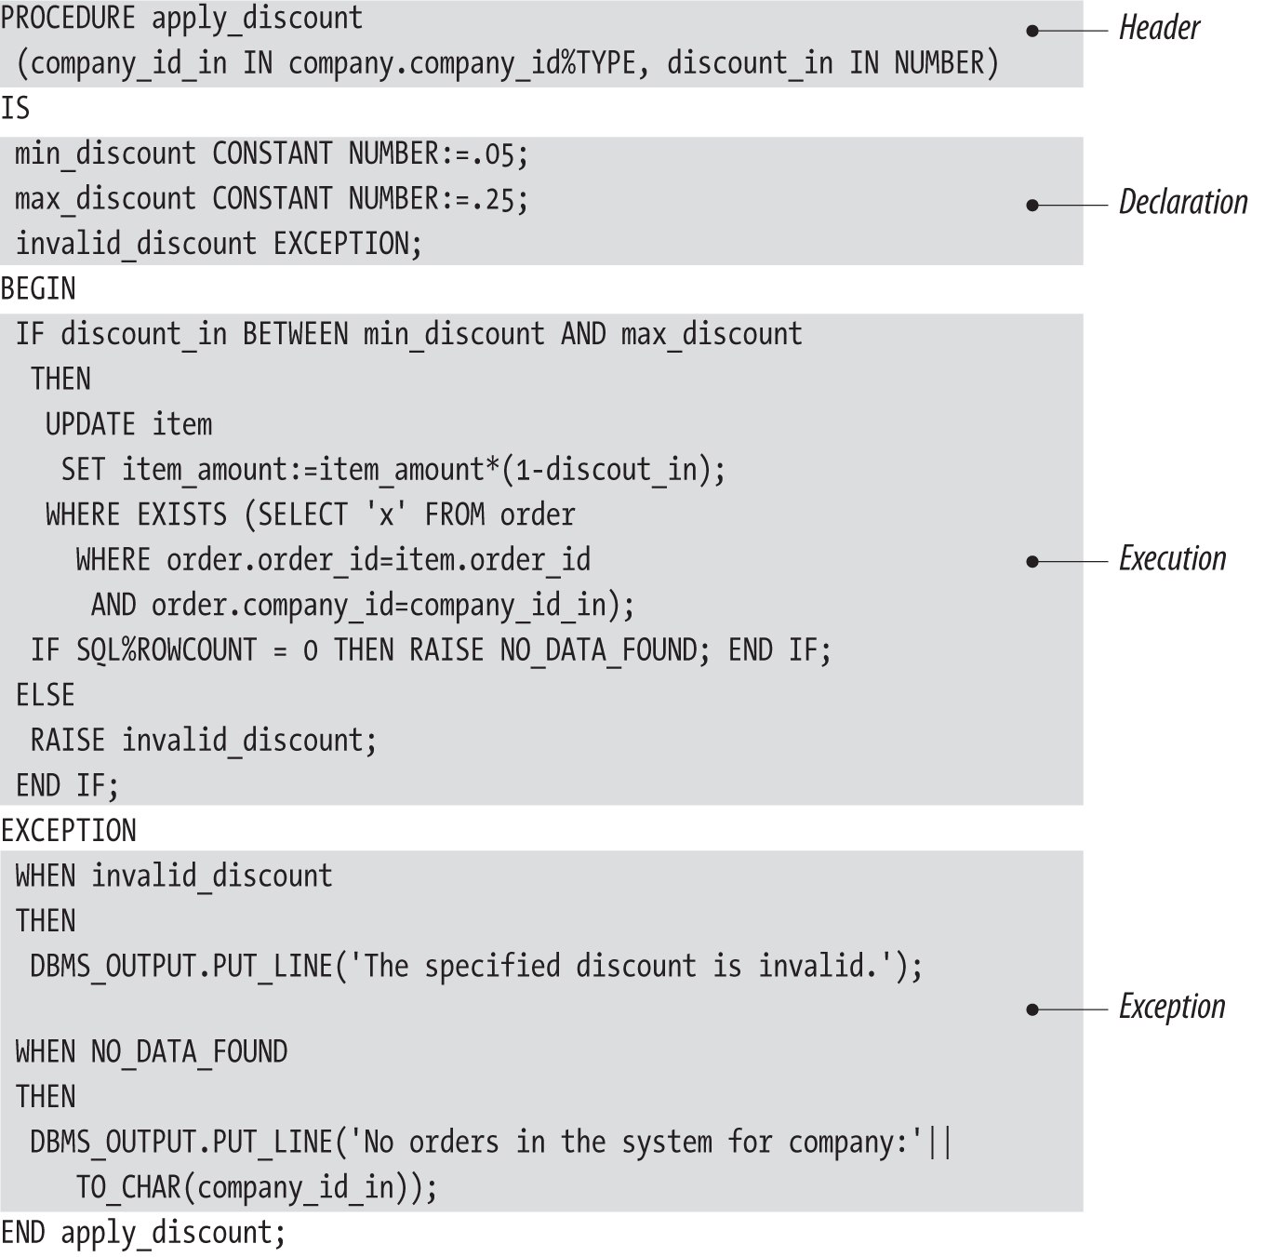
General Format of PL/SQL Procedure:
The portion of the procedure definition that comes before the AS/IS keyword is called the procedure header or signature. The header provides all the information a programmer needs to call that procedure.
The body of the procedure is the code required to implement that procedure; it consists of the declaration, execution, and exception sections of the procedure.
You can append the name of the procedure directly after the END keyword when you
complete your procedure.

Slide 15
Passing Parameters
We can pass parameters to procedures in three ways.
1) IN-parameters
2) OUT-parameters
3) IN OUT-parameters

Slide 16
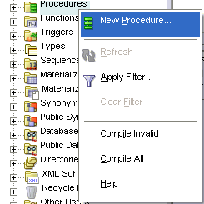
Stored Procedures & Oracle Developer
In the Connections navigation hierarchy, right-click Procedures.
Select New Procedure.

Slide 17
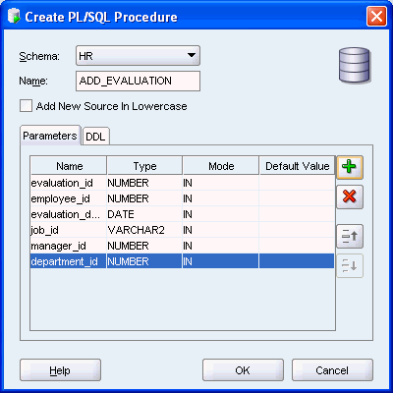
Stored Procedures & Oracle Developer
In the New Procedure window, set the following parameters:
-Ensure that you define a name for the Schema.
-Ensure that you set a name for the stored procedure.
In the Parameters tab, click the Add Column icon ('plus' sign) and specify the first parameter of the procedure.

Slide 18
Functions
A function is a named PL/SQL Block which is similar to a procedure. The major difference between a procedure and a function is, a function must always return a value, but a procedure may not return a value.
The simplified syntax for the CREATE OR REPLACE PROCEDURE statement is as follows:
CREATE [OR REPLACE] FUNCTION function_name
[(parameter_name [IN | OUT | IN OUT] type [, ...])]
RETURN return_datatype
{IS | AS}
BEGIN
< function_body >
END [function_name];

Slide 19
Functions
function-name specifies the name of the function.
[OR REPLACE] option allows modifying an existing function.
The optional parameter list contains name, mode and types of the parameters. IN represents that value will be passed from outside and OUT represents that this parameter will be used to return a value outside of the procedure.
The function must contain a return statement.
RETURN clause specifies that data type you are going to return from the function.
function-body contains the executable part.
The AS keyword is used instead of the IS keyword for creating a standalone function.

Slide 20
Examples
CREATE OR REPLACE FUNCTION minimum(v1 number, v2 number)
RETURN number IS
BEGIN
IF v1 < v2 THEN
RETURN v1;
ELSE
RETURN v2;
END IF;
END;
-----------------------------------------------------------------------------------------------------------------------------
CREATE FUNCTION get_bal(acc_no IN NUMBER)
RETURN NUMBER
IS acc_bal NUMBER(11,2);
BEGIN
SELECT balance
INTO acc_bal
FROM accounts
WHERE account_id = acc_no;
RETURN(acc_bal);
END;

Slide 21
Function with OUT parameter
CREATE OR REPLACE FUNCTION out_func (outparm OUT VARCHAR2)
RETURN VARCHAR2 IS
BEGIN
outparm := 'out param';
RETURN 'return param';
END out_func;
----------------------------------------------------------------------------------
set serveroutput on
----------------------------------------------------------------------------------
DECLARE
retval VARCHAR2(20);
outval VARCHAR2(20);
BEGIN
retval := out_func(outval);
dbms_output.put_line(outval);
dbms_output.put_line(retval);
END;

Slide 22
Function with IN OUT parameter
CREATE OR REPLACE FUNCTION inout_func (outparm IN OUT VARCHAR2)
RETURN VARCHAR2 IS
BEGIN
outparm := 'Coming out';
RETURN 'return param';
END inout_func;
--------------------------------------------------------------------------------------
set serveroutput on
--------------------------------------------------------------------------------------
DECLARE
retval VARCHAR2(20);
ioval VARCHAR2(20) := 'Going in';
BEGIN
dbms_output.put_line('In: ' || ioval);
retval := inout_func(ioval);
dbms_output.put_line('Out: ' || ioval);
dbms_output.put_line('Return: ' || retval);
END;

Slide 23
The RETURN Clause
Return a string from a standalone function:
FUNCTION favorite_nickname (
name_in IN VARCHAR2)
RETURN VARCHAR2
IS
BEGIN
...
END;
Return a number (age of a pet) from an object type member function:
TYPE pet_t IS OBJECT (
tag_no INTEGER,
NAME VARCHAR2 (60),
breed VARCHAR2(100),
dob DATE,
MEMBER FUNCTION age RETURN NUMBER
)

Slide 24
The RETURN Clause
• Return a record with the same structure as the books table:
PACKAGE book_info
IS
FUNCTION onerow (isbn_in IN books.isbn%TYPE)
RETURN books%ROWTYPE;
...
• Return a cursor variable with the specified REF CURSOR type (based on a record type):
PACKAGE book_info
IS
TYPE overdue_rt IS RECORD (
isbn books.isbn%TYPE,
days_overdue PLS_INTEGER);
TYPE overdue_rct IS REF CURSOR RETURN overdue_rt;
FUNCTION overdue_info (username_in IN lib_users.username%TYPE)
RETURN overdue_rct;
...

Slide 25
The RETURN Clause
The RETURN statement is generally associated with a function because it is required to RETURN a value from a function.
Interestingly, PL/SQL also allows you to use a RETURN statement in a procedure. The procedure version of the RETURN does not take an expression; it therefore cannot pass a value back to the calling program unit. The RETURN simply halts execution of the procedure and returns control to the calling code.
AVOID USING RETURN WITH PROCEDURES AS IT LEADS TO UNSTRUCTURED (SPAGHETTI) CODE!!!

Slide 26
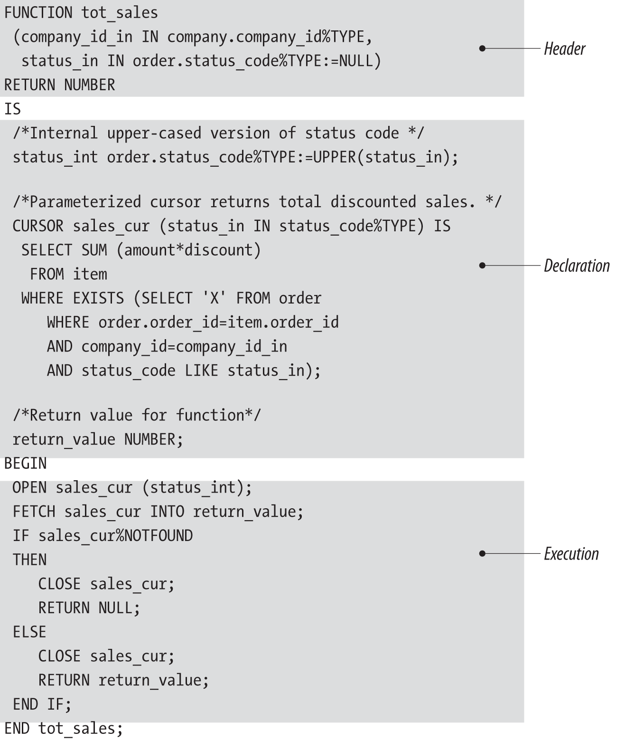
General Format of PL/SQL Function
The portion of the function definition that comes before the IS keyword is called the function header or signature. The header provides all the information a programmer needs to call that function.
The body of the function is the code required to implement the function. It consists of the declaration, execution, and exception sections of the function. Everything after the IS keyword in the function makes up that function’s body.
A function must have at least one RETURN statement in its execution section. When a RETURN statement is processed, the function terminates
immediately and returns control to the calling PL/SQL block. The RETURN clause in the header of the function is different from the RETURN statement
in the execution section of the body.

Slide 27
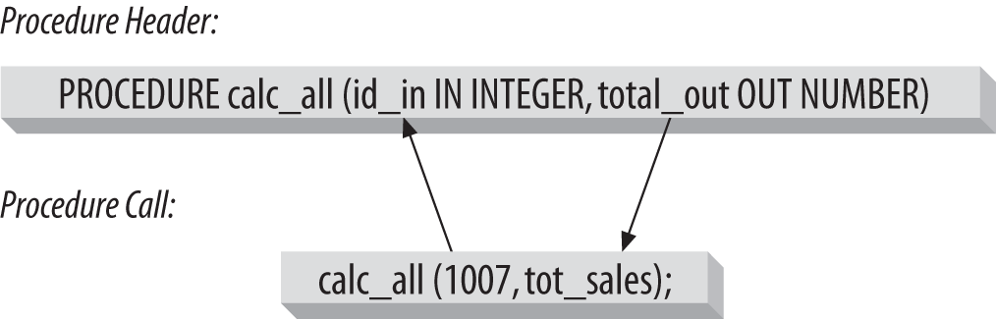
Association of Actual with Formal Parameters
How does PL/SQL know which actual parameter goes with which formal parameter when a program is executed?
formal parameter (the name of the parameter)
actual parameter (the value of the parameter)
PL/SQL offers two ways to make the association:
Positional notation
Associates the actual parameter implicitly (by position) with the formal parameter
Named notation
Associates the actual parameter explicitly with the formal parameter, using the formal parameter’s name and the => symbol
The general syntax for named notation is:
formal_parameter_name => argument_value

Slide 28
Calling a Function
When a program calls a function, program control is transferred to the called function.
A called function performs a defined task and when its return statement is executed or when its last end statement is reached, it returns program control back to the main program.
A function can be executed in the following ways.
1) Since a function returns a value, we can assign it to a variable
employee_name := employer_details_func;
If ‘employee_name’ is of datatype varchar we can store the name of the employee by assigning the return type of the function to it.
2) As a part of a SELECT statement
SELECT employer_details_func FROM dual;
3) In a PL/SQL Statements like:
dbms_output.put_line(employer_details_func);
This line displays the value returned by the function.

Slide 29
Calling a Function
4) Assign the default value of a variable with a function call:
DECLARE
v_nickname VARCHAR2(100) := favorite_nickname ('Steven');
5) Call a user-defined PL/SQL function from within a query:
DECLARE
l_name employees.last_name%TYPE;
BEGIN
SELECT last_name INTO l_name
FROM employees
WHERE employee_id = hr_info_pkg.employee_of_the_month ('FEBRUARY');

Slide 30
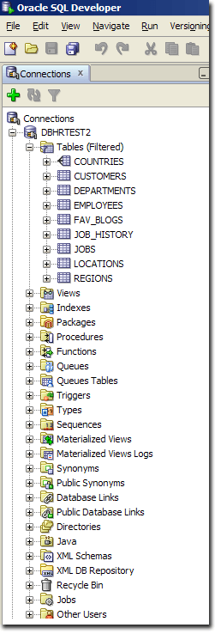
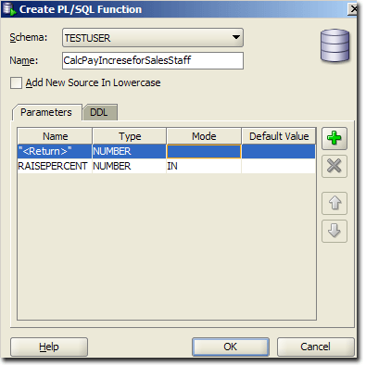
Functions and Oracle SQL Developer
To get started, right click on Functions in the connection explorer and choose New Function from the drop down menu. Doing so should display the Create PL/SQL Function window.

Slide 31
Functions vs. Stored Procedures
A Function must return a value but in a Stored Procedure this is optional
Functions can be called from a Procedure whereas Procedures cannot be called from a Function
Procedures cannot be utilized in a SELECT statement whereas a Function can be embedded in a SELECT statement
Exception can be handled by the try-catch block in a Procedure whereas the try-catch block cannot be used in a Function
Procedures allow SELECT as well as DML(INSERT/UPDATE/DELETE) statements in it whereas functions allow only SELECT statement in them

Slide 32
Packages
PL/SQL packages are schema objects that group logically related PL/SQL types, variables and subprograms.
A package is compiled and stored in the database
A package has two mandatory parts:
Package specification
Package body or definition

Slide 33
Why do we use Packages?
Modularity
Encapsulation of logically related types, such as variables, constants, subprograms, cursors, and exceptions in named PL/SQL modules. This practice aids application development.
• Easier Application Design
When designing an application, all you need initially is the interface information in the package specifications. You can code and compile specifications without their bodies. Next, you can compile standalone subprograms that reference the packages. You need not fully define the package bodies until you are ready to complete the application.

Slide 34
Why do we use Packages?
Information Hiding
Packages let you share your interface information in the package specification, and hide the implementation details in the package body. In this case, you can change the implementation details without affecting the application interface.
• Better Performance
The first time you invoke a package subprogram, Oracle Database loads the whole package into memory. Subsequent invocations of other subprograms in the same package require no disk I/O. Packages prevent unnecessary recompiling.

Slide 35
Package Specification
The specification is the interface to the package. It just DECLARES the types, variables, constants, exceptions, cursors, and subprograms that can be referenced from outside the package. In other words, it contains all information about the content of the package, but excludes the code for the subprograms.
All objects placed in the specification are called public objects.
Package Body
The package body has the codes for various methods declared in the package specification and other private declarations, which are hidden from code outside the package.
The CREATE PACKAGE BODY Statement is used for creating the package body.

Slide 36
Package Specification
The following code snippet shows a package specification having a single procedure. You can have many global variables defined and multiple procedures or functions inside a package.
CREATE PACKAGE cust_sal AS
PROCEDURE find_sal(c_id customers.id%type);
END cust_sal;
Package Body
The following code snippet shows the package body declaration for the cust_sal package created above. I assumed that we already have CUSTOMERS table created in our database as mentioned in PL/SQL - Variables chapter.
CREATE OR REPLACE PACKAGE BODY cust_sal AS
PROCEDURE find_sal(c_id customers.id%TYPE) IS
c_sal customers.salary%TYPE;
BEGIN
SELECT salary INTO c_sal
FROM customers
WHERE id = c_id;
dbms_output.put_line('Salary: '|| c_sal);
END find_sal;
END cust_sal;

Slide 37
Using the Package Elements
The package elements (variables, procedures or functions) are accessed with the following syntax: package_name.element_name;
Example
Suppose we have the following table:
SQL> Select * from customers;
+----+----------+-----+-----------+----------+
| ID | NAME | AGE | ADDRESS | SALARY |
+----+----------+-----+-----------+----------+
| 1 | Ramesh | 32 | Ahmedabad | 3000.00 |
| 2 | Khilan | 25 | Delhi | 3000.00 |
| 3 | kaushik | 23 | Kota | 3000.00 |
| 4 | Chaitali | 25 | Mumbai | 7500.00 |
| 5 | Hardik | 27 | Bhopal | 9500.00 |
| 6 | Komal | 22 | MP | 5500.00 |

Slide 38
We specify the package body:
CREATE OR REPLACE PACKAGE BODY c_package AS
PROCEDURE addCustomer(c_id customers.id%type,
c_name customers.name%type,
c_age customers.age%type,
c_addr customers.address%type,
c_sal customers.salary%type)
IS
BEGIN
INSERT INTO customers (id,name,age,address,salary)
VALUES(c_id, c_name, c_age, c_addr, c_sal);
END addCustomer;
PROCEDURE delCustomer(c_id customers.id%type) IS
BEGIN
DELETE FROM customers
WHERE id = c_id;
END delCustomer;
PROCEDURE listCustomer IS
CURSOR c_customers is
SELECT name FROM customers;
TYPE c_list is TABLE OF customers.name%type;
name_list c_list := c_list();
counter integer :=0;
BEGIN
FOR n IN c_customers LOOP
counter := counter +1;
name_list.extend;
name_list(counter) := n.name;
dbms_output.put_line('Customer(' ||counter|| ')'||name_list(counter));
END LOOP;
END listCustomer;
END c_package;
USING THE PACKAGE:
The following program uses the methods declared and defined in the package c_package.
DECLARE
code customers.id%type:= 8;
BEGIN
c_package.addcustomer(7, 'Rajnish', 25, 'Chennai', 3500);
c_package.addcustomer(8, 'Subham', 32, 'Delhi', 7500);
c_package.listcustomer;
c_package.delcustomer(code);
c_package.listcustomer;
END;

Slide 39
End of Lecture

